Slide 1
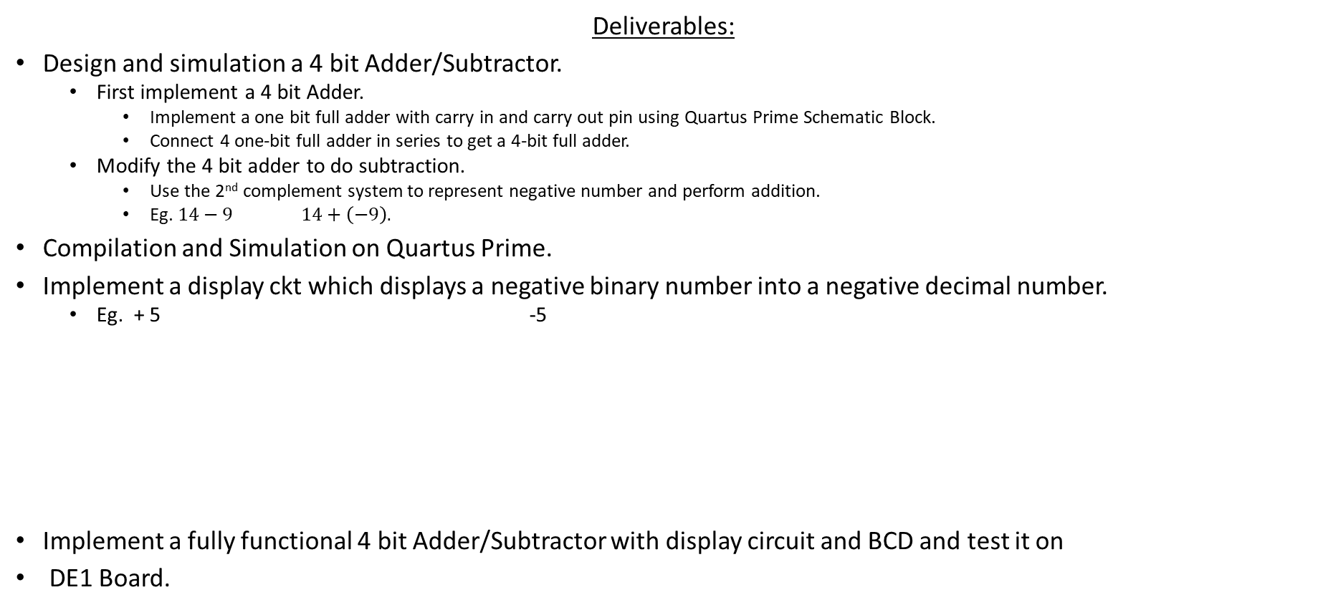
LAB-4. 4 Bit Adder/Subtractor
Deliverables:
Design and simulation a 4 bit Adder/Subtractor.
First implement a 4 bit Adder.
Implement a one bit full adder with carry in and carry out pin using Quartus Prime Schematic Block.
Connect 4 one-bit full adder in series to get a 4-bit full adder.
Modify the 4 bit adder to do subtraction.
Use the 2nd complement system to represent negative number and perform addition.
Eg. $14−9$ $14+\left(−9\right).$
Compilation and Simulation on Quartus Prime.
Implement a display ckt which displays a negative binary number into a negative decimal number.
Eg. + 5 -5
Implement a fully functional 4 bit Adder/Subtractor with display circuit and BCD and test it on
DE1 Board.
LAB 3
LAB 4

Slide 2


4 Bit Adder
LAB-3
Block diagram of a 4 bit adder .
$$A_{0}$$
Four 1 bit adders in series to get a 4 bit adder.
$$A_{1}$$
4 bit adder
$$Q_{0}$$
$$A_{2}$$
$$Q_{1}$$
$$A_{3}$$
$$Q_{2}$$
$$A_{3}$$
X
1 Bit Adder
$$B_{0}$$
$$Q_{3}$$
Sum
$$Q_{3}$$
$$A_{2}$$
$$B_{3}$$
Y
$$B_{1}$$
$$C_{out}$$
X
1 Bit Adder
$$B_{2}$$
$$B_{2}$$
Sum
$$B_{3}$$
Y
$$Q_{2}$$
Cin3
Cout
$$C_{out}$$
$$A_{1}$$
X
1 Bit Adder
Sum
$$Q_{1}$$
$$B_{1}$$
Y
Cin2
Cout2
$$A_{0}$$
X
1 Bit Adder
$$0$$
Sum
$$Q_{0}$$
$$B_{0}$$
Y
Cin1
Cout1
$$Cin$$
Cin
Cout0

Slide 3









4 Bit Subtractor
LAB-3
Block diagram of a 4 bit subtractor using 4 bit adder .
$$A_{0}$$
$$A_{1}$$
4 bit adder
$$Q_{0}$$
$$A_{2}$$
$$Q_{1}$$
$$A_{3}$$
$$Q_{2}$$
$$A_{3}$$
$$B_{3}$$
X
1 Bit Adder
$$B_{0}$$
$$Q_{3}$$
Sum
$$Q_{3}$$
$$B_{1}$$
$$Sign bit$$
$$A_{2}$$
Y
$$B_{2}$$
X
1 Bit Adder
$$B_{2}$$
Sum
$$B_{3}$$
Y
$$Q_{2}$$
Cin3
Cout
$$Sign bit$$
$$A_{1}$$
X
1 Bit Adder
$$B_{1}$$
Sum
$$Q_{1}$$
$$A_{0}$$
Y
Cin2
Cout2
X
1 Bit Adder
$$Cin$$
$$B_{0}$$
Sum
$$Q_{0}$$
$$1$$
Y
Cin1
Cout1
$$1$$
Cin
Cout0

Slide 4





Sign Bit
$$10001$$
$+ 00001$
-14
$$10010$$
Sign bit = 0+1+ carry out from (X3+Y3’).
= 1+carry out from (X3+Y3’).
$$+01001$$
-5
$$11011$$
Carry Out from (A3+B3’) | Sign Bit
1 | 0
0 | 1
Therefore, from the truth table above, Sign Bit = Not Carry out from (A3+B3’).

Slide 5
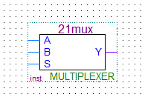
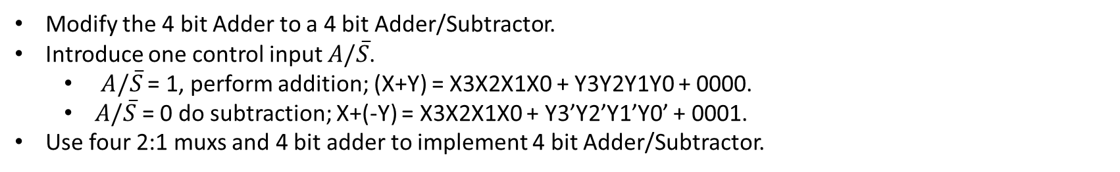
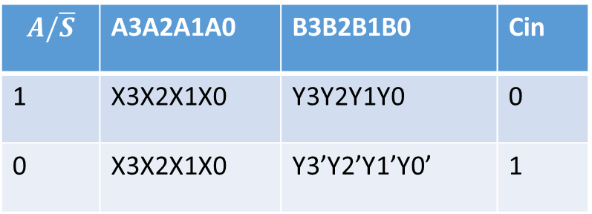
4 Bit Adder/Subtractor
Modify the 4 bit Adder to a 4 bit Adder/Subtractor.
Introduce one control input $A/\overline{S}$.
$A/\overline{S}$ = 1, perform addition; (X+Y) = X3X2X1X0 + Y3Y2Y1Y0 + 0000.
$A/\overline{S}$ = 0 do subtraction; X+(-Y) = X3X2X1X0 + Y3’Y2’Y1’Y0’ + 0001.
Use four 2:1 muxs and 4 bit adder to implement 4 bit Adder/Subtractor.
To add 2:1 mux in Quartus, find 21mux in add symbol window.
$$A/\overline{S}$$ | A3A2A1A0 | B3B2B1B0 | Cin
1 | X3X2X1X0 | Y3Y2Y1Y0 | 0
0 | X3X2X1X0 | Y3’Y2’Y1’Y0’ | 1
Select Input S | Output Y
1 | A
0 | B

Slide 6


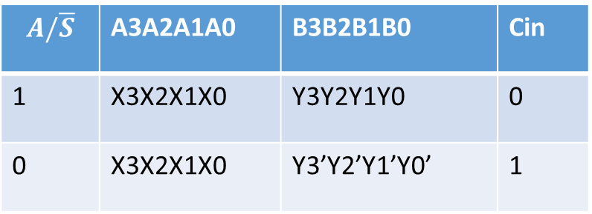














4 Bit Adder/Subtractor
$$A/\overline{S}$$ | A3A2A1A0 | B3B2B1B0 | Cin
1 | X3X2X1X0 | Y3Y2Y1Y0 | 0
0 | X3X2X1X0 | Y3’Y2’Y1’Y0’ | 1
$$X_{0}$$
$$Q_{0}$$
A0
A1
A2
A3
B0
B1
B2
B3
$$X_{1}$$
4 bit adder
Q0
Q1
Q2
Q3
$$Q_{1}$$
$$X_{2}$$
$$Q_{2}$$
A
B
S
$$X_{3}$$
$$Q_{3}$$
21
MUX
$$C_{out}$$
$$Y_{0}$$
A
B
S
Sign Bit
21
MUX
$$Cin$$
$$Y_{1}$$
S | Output Of MUX
1 | A
0 | B
A
B
S
21
MUX
$$Y_{2}$$
A
B
S
$$?$$
$$Y_{3}$$
21
MUX
$$A/\overline{S}$$
Figure out how to connect A/S’ input to 2:1 Mux inputs and Cin of the 4 bit adder.
Do the simulation on 4 bit Add/Sub.
Create a .bsf file for 4 bit add/sub.

Slide 7
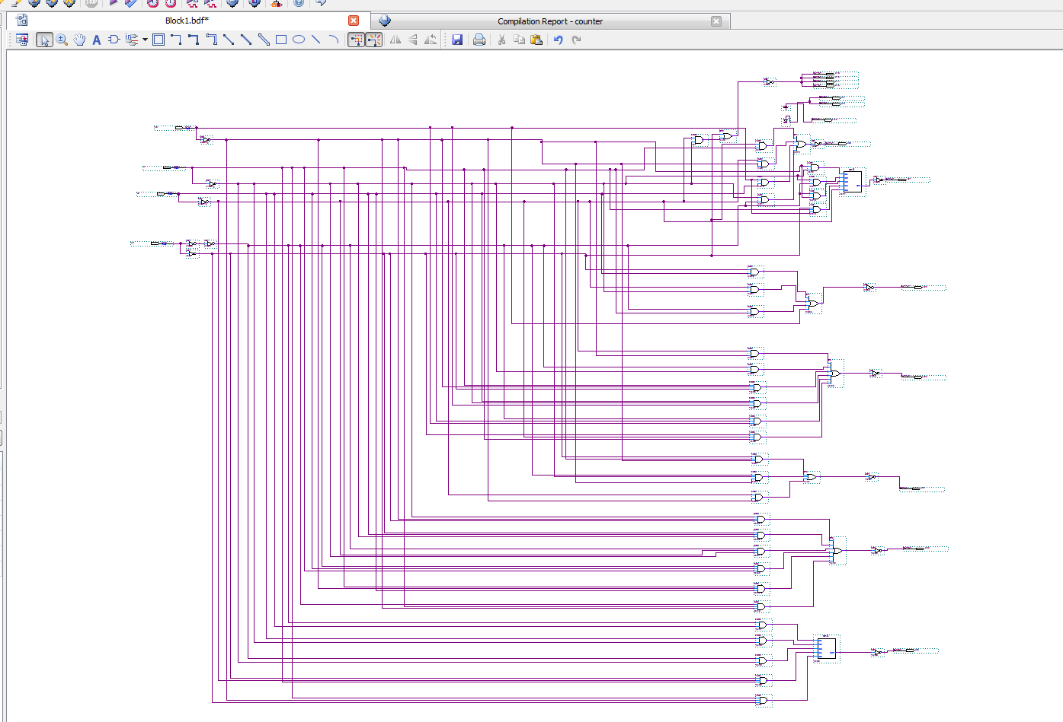
Creating a symbol block Create a .bsf file for 4 bit add/sub.
We can reuse the previous ckt by creating a block symbol instead of inserting the whole ckt.
we can create the existing ckt to a symbol block and adding in other project as a block.
Display Ckt

Slide 8
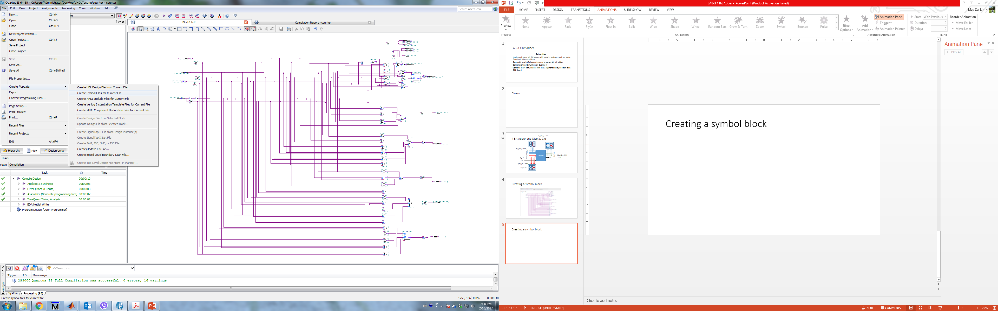
Creating a symbol block
File -> Create/Update -> Create Symbol Files for current file
save the symbol file in your project folder. This will create a .bsf file.

Slide 9
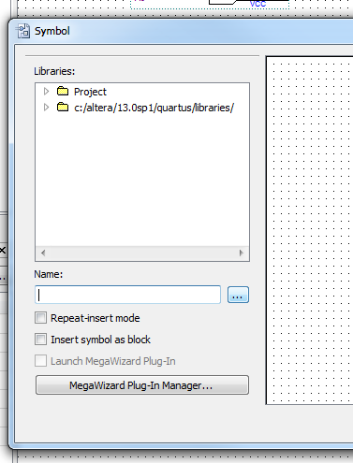
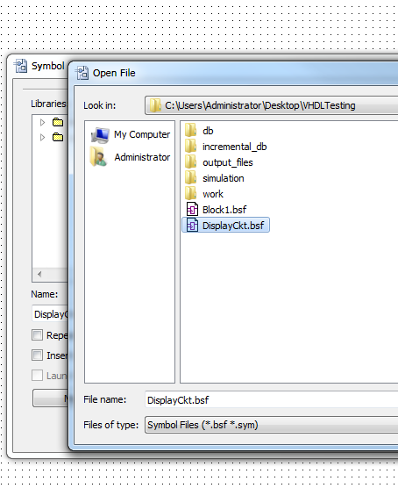
Adding Existing Ckt as a symbol to new project.
Create a new Schematic Block file and Open Symbol window from Right Click-> Insert -> Symbol.
1.
2. Select the desired .bsf file and add it the same way as you add other digital circuit components.

Slide 10













4 Bit Adder/Subtractor
1
$$X_{0}$$
$$X_{1}$$
4 bit adder
/Subtractor
$$X_{2}$$
$$Q_{0}$$
$$X_{3}$$
$$Q_{1}$$
$$Q_{2}$$
$$Q_{3}$$
$$Y_{0}$$
Sign Bit
$$Y_{1}$$
$$Y_{2}$$
$$Y_{3}$$
$$A/\overline{S}$$

Slide 11

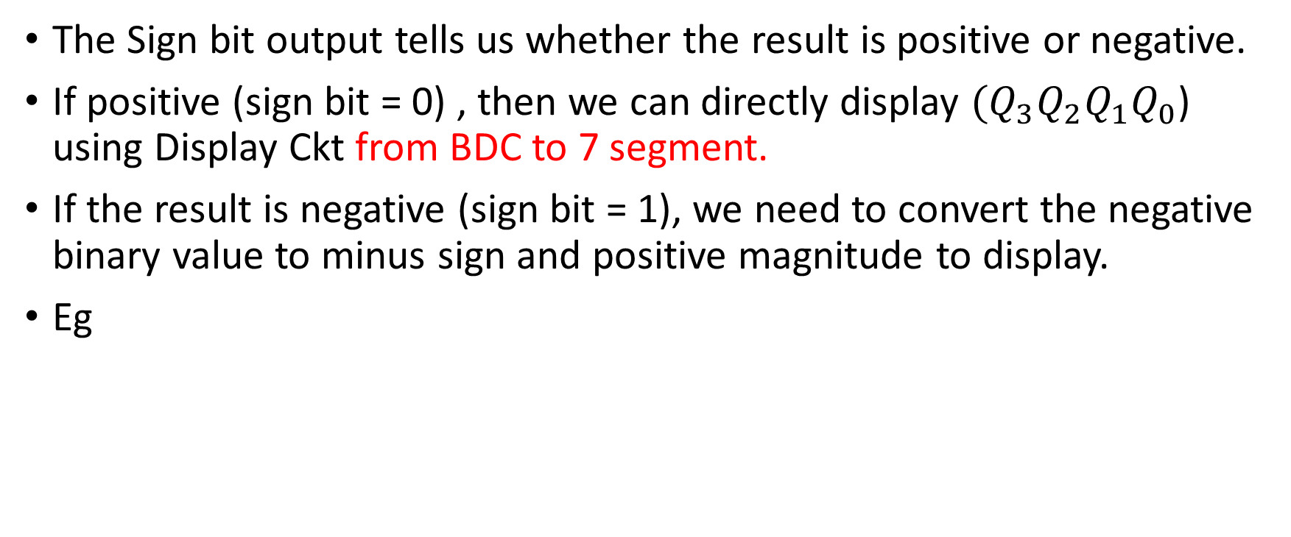

Display the Results
LAB-4
The Sign bit output tells us whether the result is positive or negative.
If positive (sign bit = 0) , then we can directly display ${(Q}_{3}Q_{2}Q_{1}Q_{0}$) using Display Ckt from BDC to 7 segment.
If the result is negative (sign bit = 1), we need to convert the negative binary value to minus sign and positive magnitude to display.
Eg
${Signout Q}_{3}Q_{2}Q_{1}Q_{0}=00101$
${Signout Q}_{3}Q_{2}Q_{1}Q_{0}=11011$
Sign
Magnitude
Sign
Magnitude

Slide 12


























Hex3
2
Operation: $14−5$
$$S_{6} S_{5}S_{4}S_{3}S_{2}S_{1}S_{0}$$
Operation: $5−14$
$Sign Bit$ = 1
1
$Sign Bit$ = 0
Sign Display
Ckt
$$X_{0}$$
4 Bit Adder/
Subtractor
$$1110$$
$$X_{1}$$
$$0101$$
$$X_{2}$$
$$X_{3}$$
Sign Display
3
4
Magnitude
Display
Magnitude Display Ckt
BCD Block Diagram
$$Y_{0}$$
$Q_{3}=1$
$$1110$$
$$Y_{1}$$
$Q_{3}=1$
$$0101$$
$$Y_{2}$$
$$Q_{2}=0$$
$$Y_{3}$$
$$Q_{2}=0$$
$$Q_{1}=0$$
$$Q_{1}=1$$
Hex1,Hex0
$$Q_{0}=1$$
$$Q_{0}=0$$
$A/\overline{S}$ = 0
$A/\overline{S}$ = 0

Slide 13







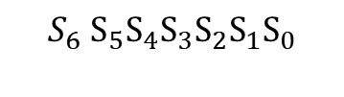







Sign Display Ckt
2
$$S_{6} S_{5}S_{4}S_{3}S_{2}S_{1}S_{0}$$
$$S_{0}$$
Sign Display
Ckt
$$S_{5}$$
$$S_{1}$$
$$Sign Bit=1$$
$$S_{6}$$
$$S_{4}$$
$$S_{2}$$
Input Sign Out | Output S6 S5 S4 S3 S2 S1 S0
0 | 1 1 1 1 1 1 1
1 | 0 1 1 1 1 1 1
$$S_{3}$$
Sign Display
$$S_{6} S_{5}S_{4}S_{3}S_{2}S_{1}S_{0}$$
$$S_{0}$$
Sign Display
Ckt
$$S_{5}$$
$$S_{1}$$
$$Sign Bit=0$$
$$S_{6}$$
VCC
$$S_{4}$$
$$S_{2}$$
$$S_{3}$$
Sign Display
$$S_{5}S_{4}S_{3}S_{2}S_{1}S_{0}$$
$$Sign Bit$$
$$S_{6}$$

Slide 14









Magnitude Display
3
$$Sign Bit$$
Combinational Ckt
$$R_{3}$$
$$Q_{3}$$
$$R_{2}$$
$$Q_{2}$$
Positive Number
$$R_{1}$$
$$Q_{1}$$
$$R_{0}$$
Sign Bit | Q3 | Q2 | Q1 | Q0 | Magnitude | R3 | R2 | R1 | R0
0 | 0 | 0 | 0 | 0 | 0 | 0 | 0 | 0 | 0
0 | 0 | 0 | 0 | 1 | 1 | 0 | 0 | 0 | 1
0 | 0 | 0 | 1 | 0 | 2 | 0 | 0 | 1 | 0
0 | 0 | 0 | 1 | 1 | 3 | 0 | 0 | 1 | 1
0 | 0 | 1 | 0 | 0 | 4 | 0 | 1 | 0 | 0
0 | 0 | 1 | 0 | 1 | 5 | 0 | 1 | 0 | 1
0 | 0 | 1 | 1 | 0 | 6 | 0 | 1 | 1 | 0
0 | 0 | 1 | 1 | 1 | 7 | 0 | 1 | 1 | 1
0 | 1 | 0 | 0 | 0 | 8 | 1 | 0 | 0 | 0
0 | 1 | 0 | 0 | 1 | 9 | 1 | 0 | 0 | 1
0 | 1 | 0 | 1 | 0 | 10 | 1 | 0 | 1 | 0
0 | 1 | 0 | 1 | 1 | 11 | 1 | 0 | 1 | 1
0 | 1 | 1 | 0 | 0 | 12 | 1 | 1 | 0 | 0
0 | 1 | 1 | 0 | 1 | 13 | 1 | 1 | 0 | 1
0 | 1 | 1 | 1 | 0 | 14 | 1 | 1 | 1 | 0
0 | 1 | 1 | 1 | 1 | 15 | 1 | 1 | 1 | 1
$$Q_{0}$$
When the result Q3Q2Q1Q0 is positive number,
R3R2R1R0 = Q3Q2Q1Q0
We can get the magnitude value of negative binary number
1. Flip 0 to 1 and 1 to 0. Eg 11011 => 00100
2. Add with 00001
00100 + 00001 => 00101 which is 5.
If Sign Bit = 0
R = Q
Else
R = not(Q) + 0001
End if;

Slide 15
















Magnitude Display Ckt
$$0$$
$$R_{0}$$
A0
A1
A2
A3
B0
B1
B2
B3
$$0$$
4 bit adder
Q0
Q1
Q2
Q3
$$R_{1}$$
$$0$$
$$R_{2}$$
A
B
S
$$0$$
$$R_{3}$$
21
MUX
$$C_{out}$$
$$Q_{0}$$
$$?$$
A
B
S
21
MUX
$$Cin$$
$$Q_{1}$$
A
B
S
21
MUX
$$Q_{2}$$
A
B
S
$$Q_{3}$$
21
MUX
$$Sign Bit$$
We can get the magnitude value of negative binary number
1. Flip 0 to 1 and 1 to 0. Eg 11011 => 00100
2. Add with 00001
00100 + 00001 => 00101 which is 5.

Slide 16
BCD Block Diagram
4
BCD Block Diagram
Design a circuit to decode a 8 bit binary to BCD and combine with a display circuit from Lab 2.
A BCD is a binary system which represents one decimal number with 4 binary number.
15 → 1111 (in Binary)
15 →0001 0101 (in BCD)
Implement a ckt that convert a 8 bit binary input to two BCD.
Maximum binary the ckt can decode is 99.
When the input is higher than 99, overflow = ‘1’.

Slide 17
BCD: Binary Coded Decimal
Decimal | Binary Number | BCD Outputs | OverFlow
0 1 . . . | 0000 0000 0000 0001 . . . | 0000 0000 0000 0001 | 0 . . .
9 | 0000 1001 | 0000 1001 | 0
10 | 0000 1010 | 0001 0000 | 0
11 | 0000 1011 | 0001 0001 | 0
12 | 0000 1100 | 0001 0010 | 0
. . . 99 | . . . 0110 0011 | 1001 1001 | . . . 0
100 | 0110 0100 | xxxx xxxx | 1

Slide 18
Binary to BCD
To convert the binary 1111 to BCD, simply add 0110 (6) to 1111.
1111 + 0110 = 1 0101
How about decimal 34?
10 0010 + 0110 = 10 1000
0001 0101
34
0010 1000
2 8
BCD value incorrect..

Slide 19
Shift Add 3 Alg
Do 8 times ( for 8 bit binary input).
1. Shift left one to the binary input.
2. Add 3 to BCD if it’s greater than 4.
3. Go to 1.

Slide 20
Shift Add 3 Alg
Eg. Convert 34 to BCD using Shift Add 3 Alg.
34 = 10 0010
Start output = 0000 0000 (Since we went to convert the input two BCDs.)
Take the first 3 MSB of inputs and add to output.
Output = 0000 0100
Check whether output is greater than 4. If so add 3 to output.
Shift left one.
Output = 0000 1000
If output is greater than 4 add 3.
Output = 0000 1000 + 0000 0011 = 0000 1011
Shift left one.
Output = 0001 0111
If output is greater than 4 add 3.
Output = 0001 0111 + 0000 0011 = 0001 1010
Shift left one.
Output = 0011 0100
3
4

Slide 21
Shift Add 3 Alg
Input = HGFE DCBA
Take the first 3 MSB of inputs and add to output.
Output = 0000 0HGF
If 00HGF > 4
I H1 G1 F1 = 0 H G F + 0011.
Else
I H1G1F1 = 0 H G F
Shift left one.
Output = 000I H1 G1 F1 E
If H1 G1 F1 E > 4
H2 G2 F2 E1 = H1 G1 F1 E + 0011.
Else
H2 G2 F2 E1 = H1 G1 F1 E
Shift left one.
Output = 00I H2 G2 F2 E1 D
If G2 F2 E1 D > 4
G3 F3 E2 D1 = G2 F2 E1 D + 0011.
Else
G3 F3 E2 D1 = G2 F2 E1 D
Shift left one.
Output = 0I H2 G3 F3 E2 D1 C
If 0I H2 G3 > 4
J I1 H3 G4 = 0 I H2 G3 + 0011.
Else
J I1 H3 G4 = 0 I H2 G3
If F3 E2 D1 C > 4
F4 E3 D2 C1 = F3 E2 D1 C + 0011.
Else
F4 E3 D2 C1 = F3 E2 D1 C
Shift left one.
Output = I1 H3 G4 F4 E3 D2 C1 B
If I1 H3 G4 F4 > 4
I2 H4 G5 F5 = I1 H3 G4 F4 + 0011.
Else
I2 H4 G5 F5 = I1 H3 G4 F4
If E3 D2 C1 B > 4
E4 D3 C2 B1 = E3 D2 C1 B+ 0011.
Else
E4 D3 C2 B1 = E3 D2 C1 B
Shift left one.
Output= H4 G5 F5 E4 D2 C2 B1 A

Slide 22


Add 3 Ckt
If Input $>$ 4
Output = Input +3;
Else
Output = Input;
End
Input X3X2X1X0 | Output P3P2P1P0
0000 0001 0010 0011 0100 0101 0110 0111 1000 1001 | 0000 0001 0010 0011 0100 1000 1001
1010 . . 1111 | xxxx . . xxxx
When $input ≤4$.
Input = 0101 (which is greater than 4)
Output = 0101 + 0011 = 1000
Fill these outputs
When input > 9, don’t care.

Slide 23
Add 3 Ckt
Complete the Truth Table from prev slide
Find the Boolean expression for P3, P2, P1 and P0.
Implement the Ckt .
Simulate the ckt (screen shots for report.)
Create a block symbol (bsf) file for Add-3 ckt. Creating a symbol block
Add -3
Ckt
X3
X2
X1
X0
P3
P2
P1
P0

Slide 24
If 0HGF > 4
I H1 G1 F1 = 0 H G F + 0011.
Else
I H1G1F1 = 0 H G F
Shift left one.
Output = 000I H1 G1 F1 E
If H1 G1 F1 E > 4
H2 G2 F2 E1 = H1 G1 F1 E + 0011.
Else
H2 G2 F2 E1 = H1 G1 F1 E
Shift left one.
Output = 00I H2 G2 F2 E1 D
If G2 F2 E1 D > 4
G3 F3 E2 D1 = G2 F2 E1 D + 0011.
Else
G3 F3 E2 D1 = G2 F2 E1 D
Shift left one.
Output = 0I H2 G3 F3 E2 D1 C
If 0I H2 G3 > 4
J I1 H3 G4 = 0 I H2 G3 + 0011.
Else
J I1 H3 G4 = 0 I H2 G3
If F3 E2 D1 C > 4
F4 E3 D2 C1 = F3 E2 D1 C + 0011.
Else
F4 E3 D2 C1 = F3 E2 D1 C
Shift left one.
Output = I1 H3 G4 F4 E3 D2 C1 B
If I1 H3 G4 F4 > 4
I2 H4 G5 F5 = I1 H3 G4 F4 + 0011.
Else
I2 H4 G5 F5 = I1 H3 G4 F4
If E3 D2 C1 B > 4
E4 D3 C2 B1 = E3 D2 C1 B+ 0011.
Else
E4 D3 C2 B1 = E3 D2 C1 B
Shift left one.
Output= H4 G5 F5 E4 D2 C2 B1 A
Let’s the final output of BCD = U3U2U1U0 L3L2L1L0
Input = HGFE DCBA
0
H
G
F
Add-3
Ckt
I
H1
G1
F1
X3
X2
X1
X0
P3
P2
P1
P0
H1
G1
F1
E
Add-3
Ckt
H2
G2
F2
E1
X3
X2
X1
X0
P3
P2
P1
P0
G2
F2
E1
D
Add-3
Ckt
G3
F3
E2
D1
X3
X2
X1
X0
P3
P2
P1
P0
0
I
H2
G3
Add-3
Ckt
J
I1
H3
G4
X3
X2
X1
X0
P3
P2
P1
P0
F3
E2
D1
C
Add-3
Ckt
F4
E3
D2
C1
X3
X2
X1
X0
P3
P2
P1
P0
I1
H3
G4
F4
Add-3
Ckt
I2
H4
G5
F5
X3
X2
X1
X0
P3
P2
P1
P0
E3
D2
C1
B
Add-3
Ckt
E4
D3
C2
B1
X3
X2
X1
X0
P3
P2
P1
P0

Slide 25
BCD
0
H
G
F
Add-3
Ckt
I
H1
G1
F1
X3
X2
X1
X0
P3
P2
P1
P0
H1
G1
F1
E
Add-3
Ckt
H2
G2
F2
E1
X3
X2
X1
X0
P3
P2
P1
P0
Output= H4 G5 F5 E4 D3 C2 B1 A
( from previous slide)
Name the final output of BCD as
Output = U3U2U1U0 L3L2L1L0
Use I2 as Overflow.
G2
F2
E1
D
Add-3
Ckt
G3
F3
E2
D1
X3
X2
X1
X0
P3
P2
P1
P0
0
I
H2
G3
Add-3
Ckt
J
I1
H3
G4
X3
X2
X1
X0
P3
P2
P1
P0
F3
E2
D1
C
Add-3
Ckt
F4
E3
D2
C1
X3
X2
X1
X0
P3
P2
P1
P0
I1
H3
G4
F4
Add-3
Ckt
Overflow
U3
U2
U1
X3
X2
X1
X0
P3
P2
P1
P0
E3
D2
C1
B
Add-3
Ckt
U0
L3
L2
L1
X3
X2
X1
X0
P3
P2
P1
P0
A = L0.

Slide 26
BCD Block Diagram
Implement the BCD Ckt from previous slide.
Simulate the ckt (screen shots for report.)
Create a block symbol (bsf) file for BCD circuit.
Creating a symbol block
BCD Block Diagram
A
B
C
D
E
F
G
H
U0
U1
U2
U3
L0
L1
L2
L3
Overflow

Slide 27
BCD Circuit with 7 Segment Display
Create a block symbol (bsf) file for the display circuit (Lab 2).
Combine BCD and display circuit as below.
Create a block symbol (bsf) file for the combined circuit.
Lab 2
0010 (2 for tens Display)
D10
D11
D12
D13
D14
D15
D16
BCD Ckt
0001 1001 (25 in Decimal)
U0
U1
Display
ckt
X0
X1
X2
x3
D0
D1
D2
D3
D4
D5
D6
A
B
C
D
E
F
G
H
U2
U3
L0
L1
Display
ckt
D00
D01
D02
D03
D04
D05
D06
X0
X1
X2
x3
D0
D1
D2
D3
D4
D5
D6
L2
L3
0101 (5 for units Display)
Overflow

Slide 28
BCD Top Level
4
3
BCD
Top Level
D10
D11
D12
D13
D14
D15
D16
Hex1
Magnitude Display Ckt
A
B
C
D
E
F
G
H
D00
D01
D02
D03
D04
D05
D06
Hex0
Overflow assigns to one of the LEDs.

Slide 29
















Toplevel Ckt - 4 Bit Add/Sub and Display Ckt
Hex3
2
$$S_{6} S_{5}S_{4}S_{3}S_{2}S_{1}S_{0}$$
1
$$Sign Bit$$
Sign Display
Ckt
$$X_{0}$$
4 Bit Adder/
Subtractor
$$X_{1}$$
$$X_{2}$$
$$X_{3}$$
Sign Display
3
4
Magnitude
Display
Magnitude Display Ckt
BCD Block Diagram
$$Y_{0}$$
$$Y_{1}$$
$$Q_{3}$$
$$Y_{2}$$
$$Y_{3}$$
$$Q_{2}$$
$$Q_{1}$$
Hex1,Hex0
$$Q_{0}$$
Assign $Q_{3}Q_{2}Q_{1}Q_{0}$to LEDS
$A/\overline{S}$

Slide 30
Lab 4 Top Level Circuit Diagnosis
Run the simulation for the top level circuit from previous slide.
You will see some errors in addition results.
That is due to the sign bit.
Do some modification to your final circuit to get the correct answer (10 points).
Notes:
The Adder Substractor won’t work as is. A solution is to have the sign output connect to XNOR(A_S signal , COUT). This lets COUT through during addition and flips it for subtraction

Slide 31
Extra Credits
Can you modify your circuit to accept negative decimal inputs? (20 points for Final project.)

Slide 32
Project Flow Chart
Simulation waveform on Quartus Prime. (Screen shot the result and add it in the report.)
Implement a Sign Display Ckt and a Magnitude Display Ckt.
Implement a Top Level Ckt.
Pin Assignment.
Download the Top Level ckt to the DE1 Board.
Take a photo of your final circuit running on the board and add it in the report.

Slide 33
Report
Follow the sample report for details.
Objective (10 points)
Equipment (10 points)
Description(10 points)
Design Synthesis (20 points)
Kmaps and Boolean Expressions
Complete logic Diagram from Quartus prime(20 points)
Screenshot of your Complete Circuit block diagram
Results and Simulation (10 points)
Photos of your circuit on DE1 Board.
Conclusion (20 points).

